Slide 1




CONSUMER
GOODS
ANALYSIS
PRESENTED BY
Akshit Singhal
24-JAN-2023

Slide 2
Problem statement-
Atliq Hardwares (imaginary company) is one of the leading computer hardware producers in India and well expanded in other countries too. They want to to make quick and smart data-informed decisions to expand in different markets.

Slide 3
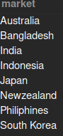
Request-1
List of market in which customer "Atliq Exclusive" operates its business in the "APAC" region

Slide 4
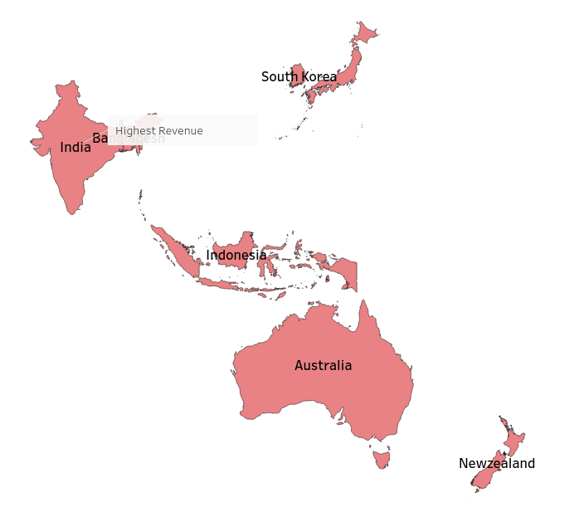
Altiq Exclusive operates in
eight different market
in APAC Regions.
India is highest revenue market in APAC region

Slide 5
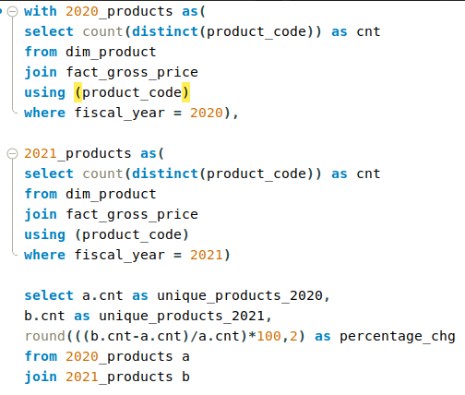
Request-2
What is the percentage of unique product increase in 2021 vs. 2020?

Slide 6

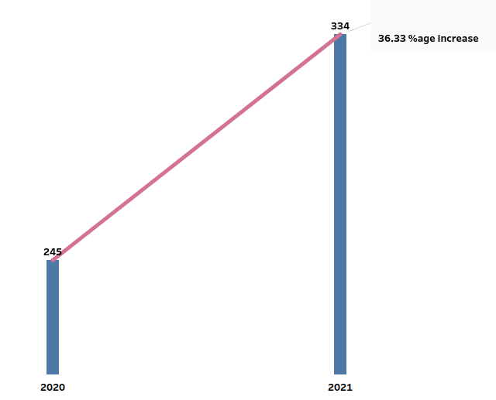
36.33% YoY increase
in product count
from 245 in 2020
to 334 in 2021

Slide 7
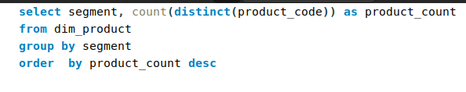
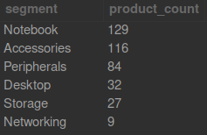
Request-3
Unique product count
by segment

Slide 8
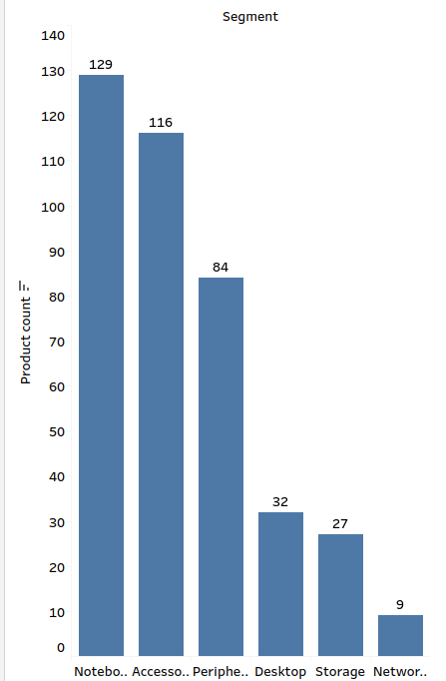
Notebook segmenent has highest products i.e. 129 followed by
Accessories segment that have 116 unique products.
Network segment has 9 products only.

Slide 9
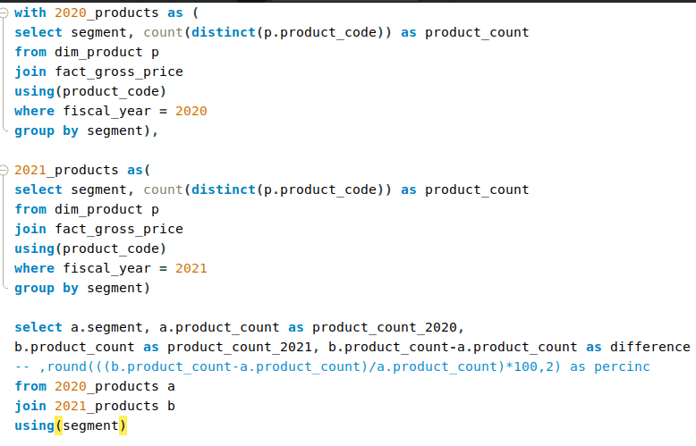
Request-4
Which segment had the most
increase in unique products in
2021 vs 2020?

Slide 10
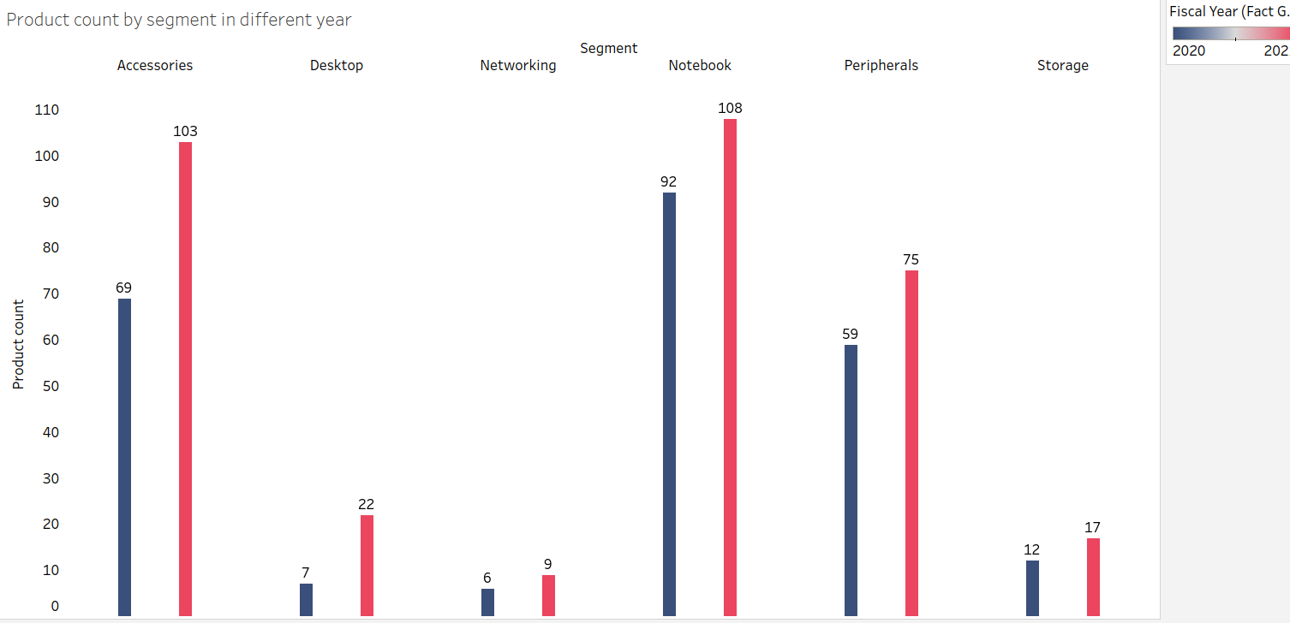
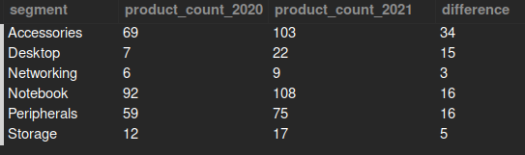
Desktop segment has highest 214%increase in product count
Notebook segment has lowest 17% increase in product count
Accessories segment has added 34 new products from 2020 to 2021 highest in all.

Slide 11
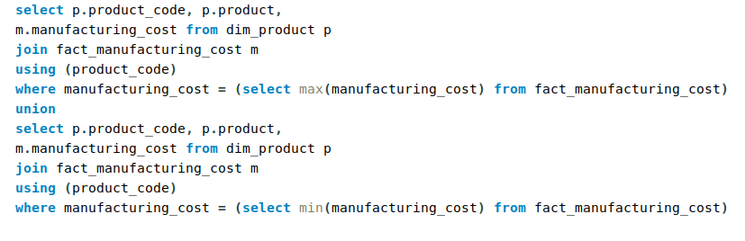

Request-5
Products that have the
highest and lowest manufacturing costs.

Slide 12
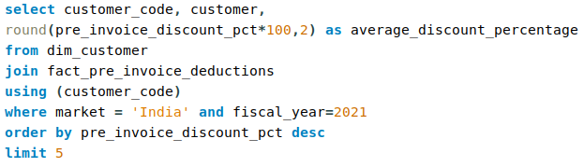
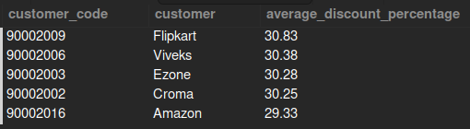
Request-6
Top 5 customers who
received an average high pre_invoice_discount_pct
for the fiscal year 2021
and in theIndian market

Slide 13
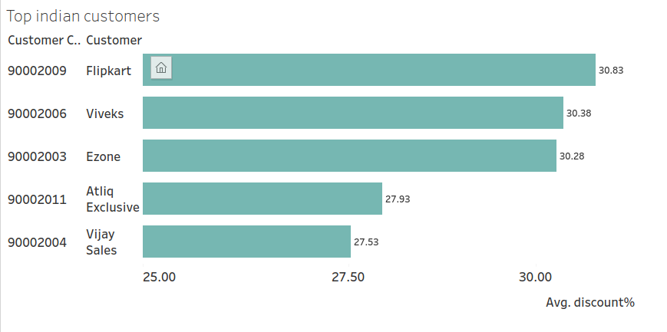
Flipkart receive highest pre invoice discount in year 2021 from indian market

Slide 14
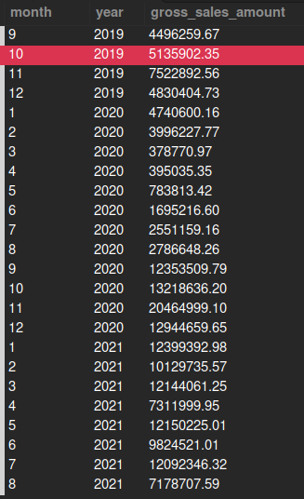
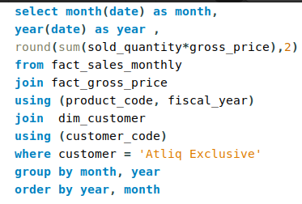
Request-7
Gross sales amount for the customer “Atliq
Exclusive” for each month

Slide 15
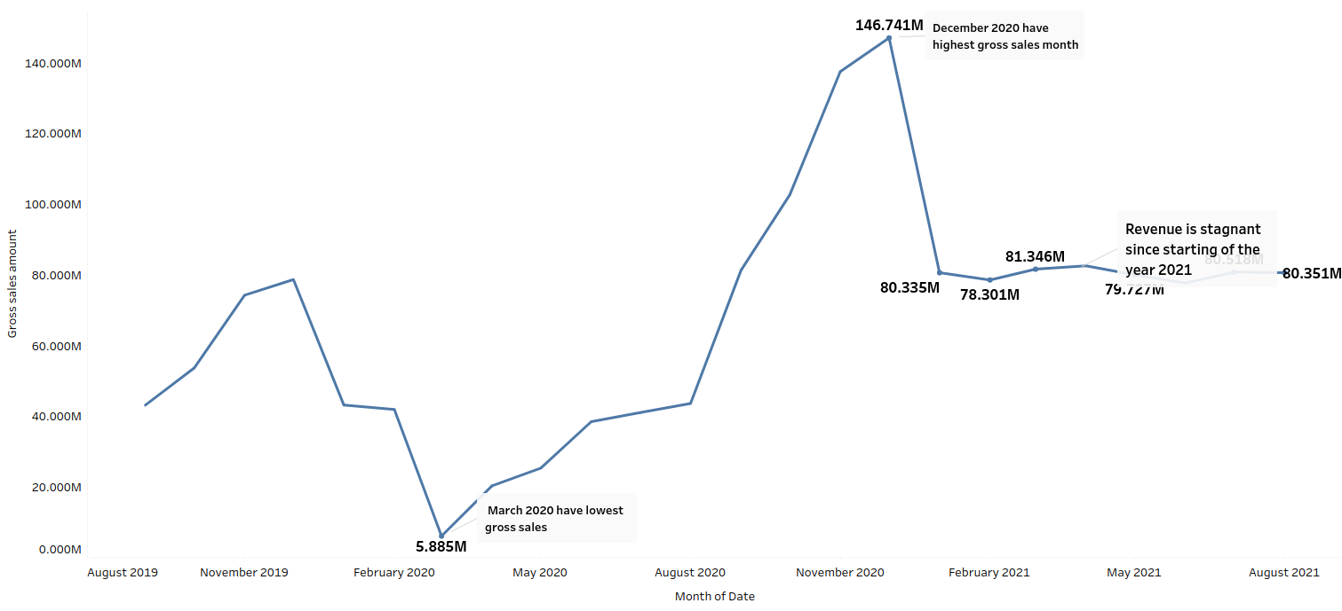

Slide 16
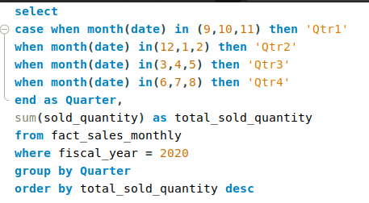
Request-8
Total_sold_quantity by quarter in year 2020

Slide 17
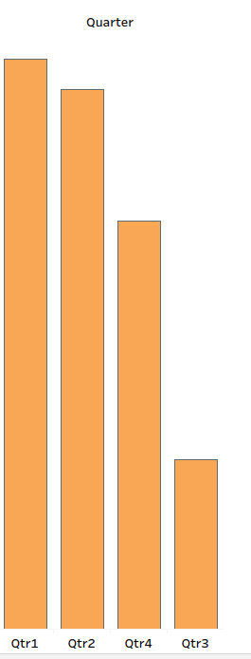
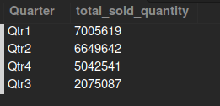
In year 2020 Quarter-1 have highest number of sold_quantity while Quarter-3 been a lowest sold_quantity

Slide 18
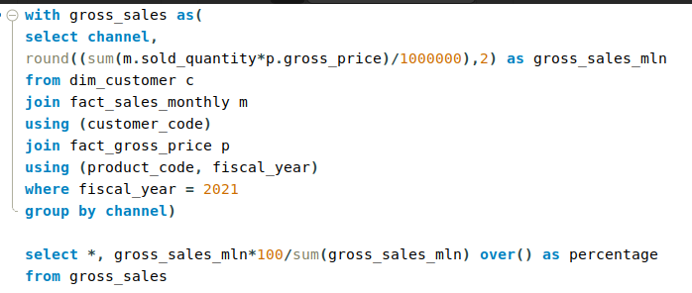
Request-9
Gross sales per channel in 2021

Slide 19
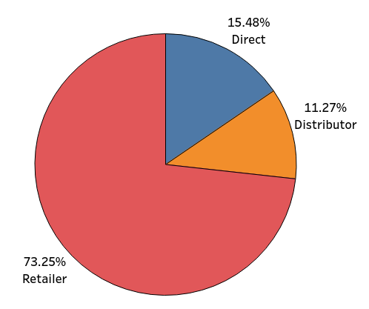
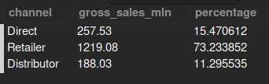
Retail channel contribute (73%) maximum gross-sales in 2021

Slide 20
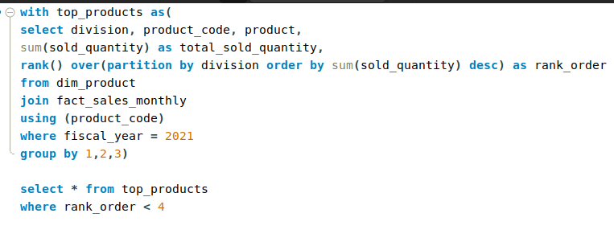
Request-10
Top 3 products in each division that have a high
total_sold_quantity in the fiscal_year 2021

Slide 21
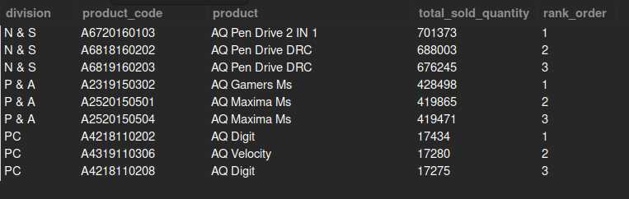
List of top 3 products in each division that have a high
total_sold_quantity in the fiscal_year 2021.
PC division have less total_sold_qty then other division.
Pen drive is most sold product from all
divisions.

Slide 22
Akshit Singhal

